Slide 1
Growing a Classification Tree Using the Apparent Misclassification Rate
E.Zintzaras, N.P.Brown and A.Kowald
CABIOS, Vol.l0. no.3, pp. 263 – 271, 1994
Date: Aug. 12, 2005
Created by Jing-Liang Hsin

Slide 2
Abstract
A method to determine the size of a classification tree is
proposed. This method is based on the change of the apparent
misclassification rate (AMR) of the tree at each growing stage.
To test the method, it was used to classify species of fungi, and
the results are in good agreement with those obtained by linear
discriminant analysis. Also, 21 proteins with known structures and
functions were classified using the proposed method. For this
purpose the coefficient of variation for several properties of the
secondary structures of these proteins has been used. Again. the
results were in good agreement with the classification obtained
previously using dynamic programming.

Slide 3
Methods
If X_{l} , X₂ , . . ., X_{k} are the measurements made on an individual, the algorithm sorts the individuals according to each variable.
It finds for each variable the threshold that gives the best split.
The split that best separates the classes, compares these splits and chooses the best variable and split combination.
The node t is split into two subnodes t_{l} and t_{r} , the proportion of the individuals in t that go to t_{l} and t_{r} are P_{l} and P_{r} .

Slide 4
Methods
After each split, the AMR of the tree is calculated.If the next split improves the AMR by a certain percentage ,e.g. 5% (the program allows any value), that split is accepted, otherwise the node becomes a terminal node.

Slide 5
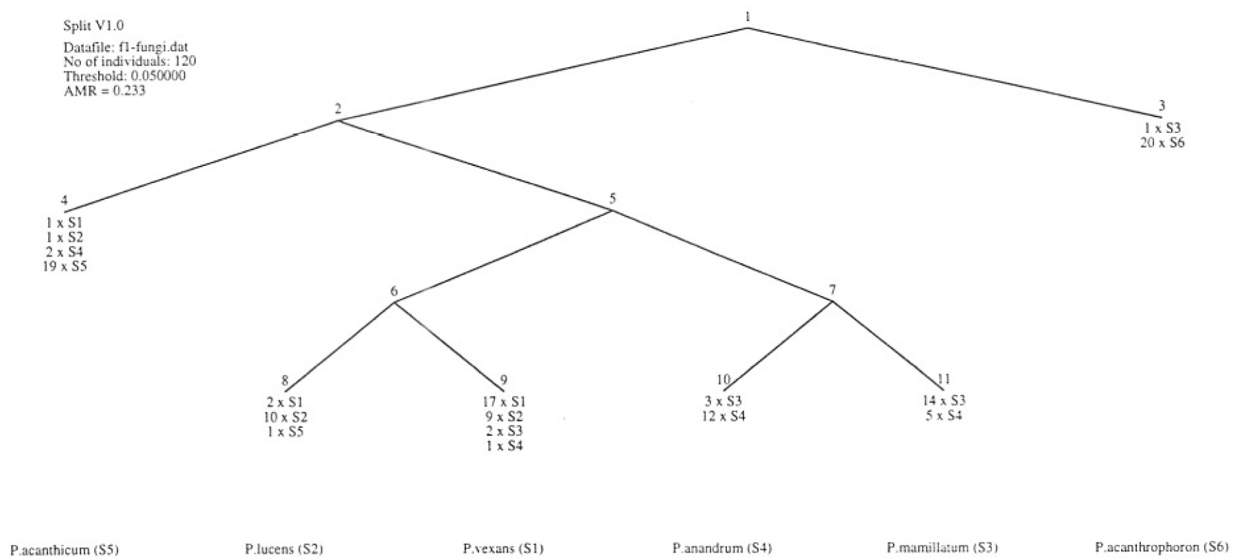
Example 1

Slide 6
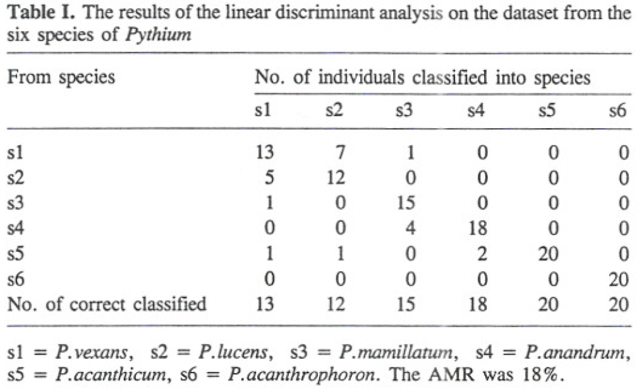
Example 1

Slide 7
Example 2
V₁ = protein size as number of possible pairs of secondary structures
V₂ = distance between the centres of two secondary structures
V₃ = distance between ends of secondary structures
V₄ = intercentroid tilt angles between two structures
V₅ = intercentroid angles between two structures
V₆ = hydrophobic moment vector angle
V₇ = centroid moment vector angle
V₈ = connecting loop lengtl1as number of amino acid residues between secondary structures

Slide 8
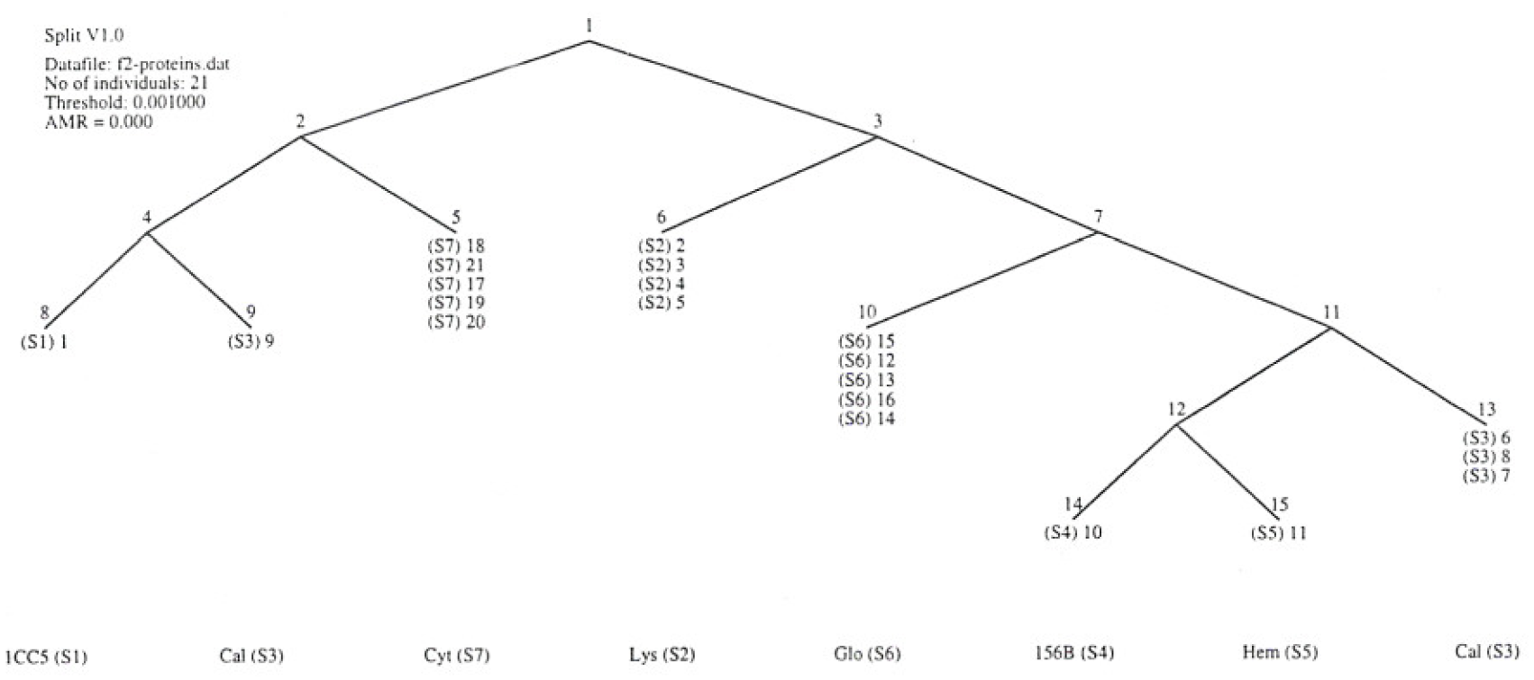
Example 2

Slide 9
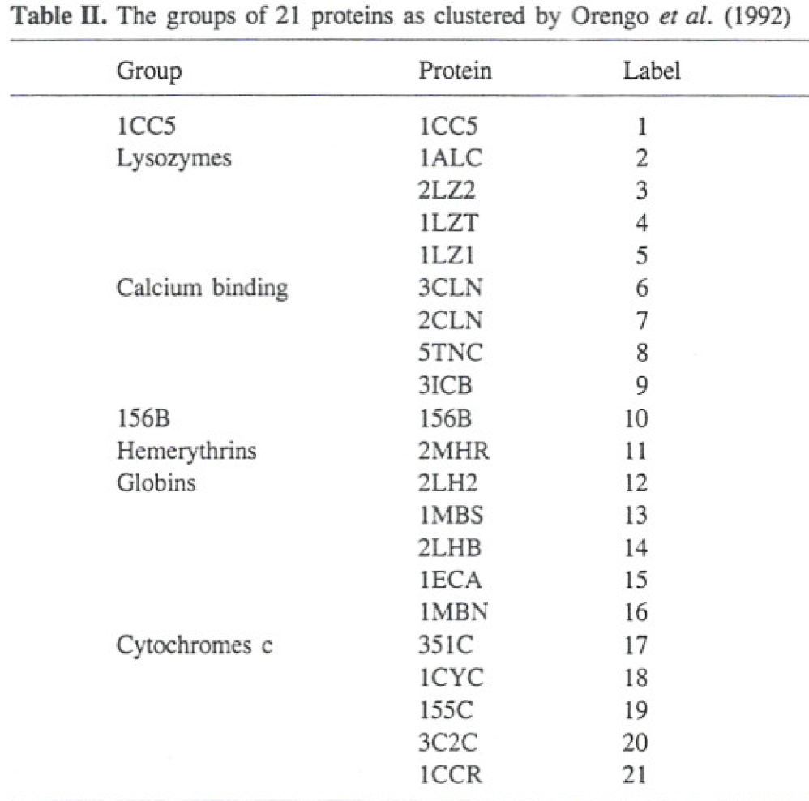
Example 2

